Slide 1


IBM Research AI Intern Project Machine Learning Pipeline Recommendation Manager: Anuradha Bhamidipaty Mentors: Chandra Reddy, Dhaval Patel Presenter: Yuhan Shao Contact Info: : @yuhan.shao : Yuhan.Shao@ibm.com

Slide 2

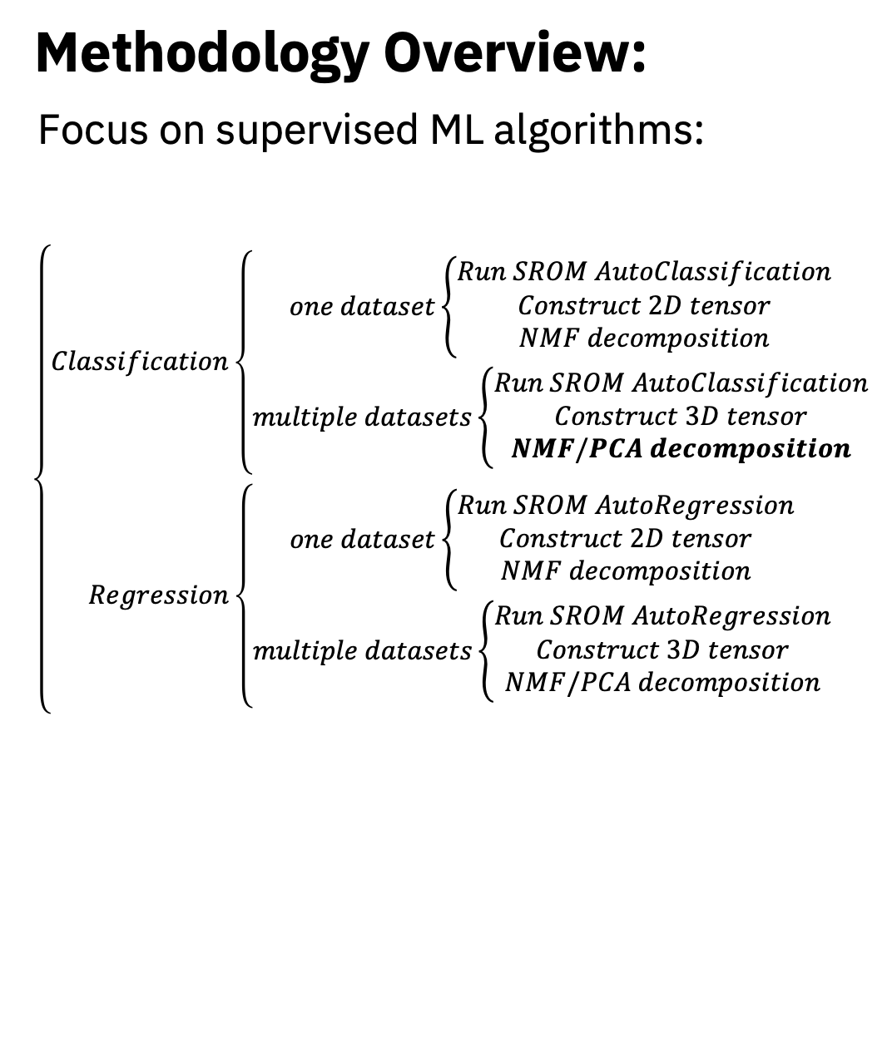
Introduction: we propose a new approach that: ⚬ Inspired by the matrix-factorization approaches in the recommender system to quickly recommend the best pipeline with assigned parameter values on a dataset that has not been tried on. ⚬ In addition, our approach would help understand how different models/pipelines perform on different instances of a dataset or on multiple datasets.
Methodology Overview:
Focus on supervised ML algorithms:
$$\left\{\begin{aligned}Classification\left\{\begin{aligned}one dataset\left\{\begin{aligned}Run SROM AutoClassification \\ Construct 2D tensor \\ NMF decomposition\end{aligned}\right. \\ multiple datasets\left\{\begin{aligned}Run SROM AutoClassification \\ Construct 3D tensor \\ NMF/PCA decomposition\end{aligned}\right.\end{aligned}\right. \\ Regression\left\{\begin{aligned}one dataset\left\{\begin{aligned}Run SROM AutoRegression \\ Construct 2D tensor \\ NMF decomposition\end{aligned}\right. \\ multiple datasets\left\{\begin{aligned}Run SROM AutoRegression \\ Construct 3D tensor \\ NMF/PCA decomposition\end{aligned}\right.\end{aligned}\right.\end{aligned}\right.$$

Slide 3
Terminology
an algorithm that fits on the input dataset to generate the ‘best’ model
consists of multiple sequential steps
the common sequential stages that each ML pipeline includes.
E.g.: 1) Data Ingestion; 2) Data Validation; 3) Data Pre-processing; 4) Model Training & Tuning; 5) Model Analysis
Examples from SROM output:
Pipeline(steps=[('bernoullinb', BernoulliNB(binarize=0.75, fit_prior=False))])
Pipeline(steps=[('bernoullinb’, BernoulliNB(alpha=0.001, binarize=0.9, fit_prior=False))])
Pipeline(steps=[('featureagglomeration', FeatureAgglomeration()), ('adaboostclassifier’, AdaBoostClassifier(learning_rate=0.5, n_estimators=500, random_state=42))])]
Estimator:
Pipeline:
Step:

Slide 4
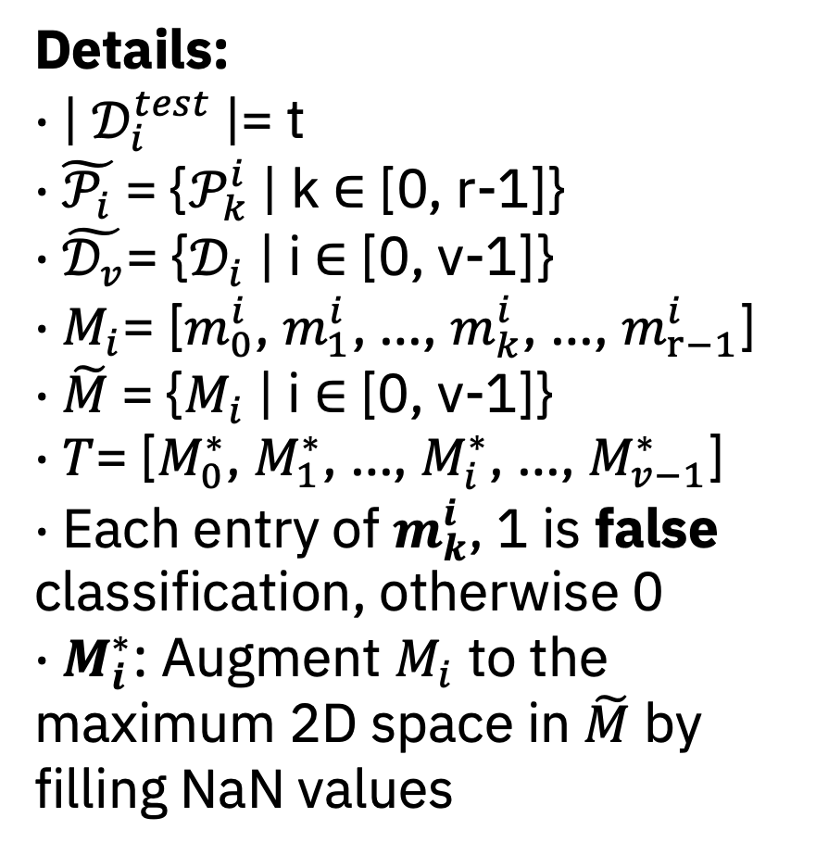
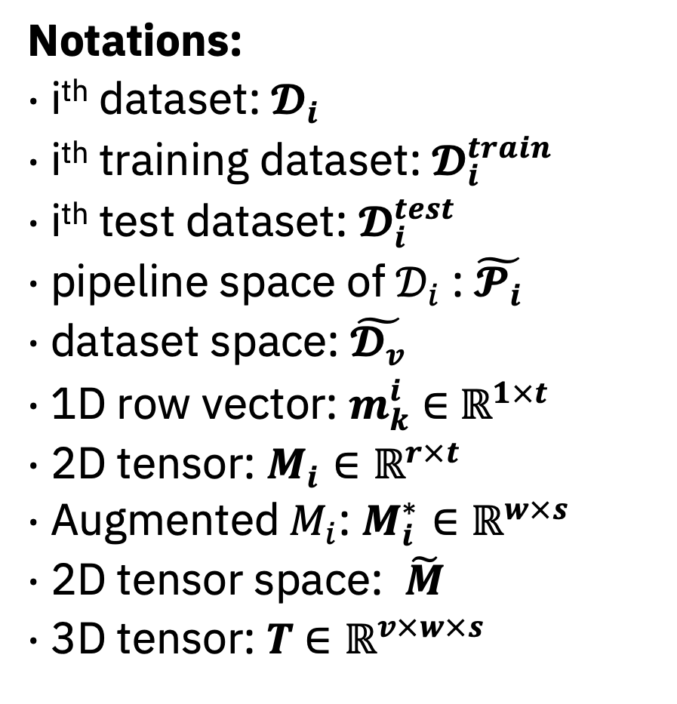
Notations: $∙$ i^{th} dataset: $𝓓_{i}$ $∙$ i^{th} training dataset: $𝓓_{i}^{train}$ $∙$ i^{th} test dataset: $𝓓_{i}^{test}$ $∙$ pipeline space of $𝒟_{i}$: $\tilde{𝓟_{i}}$ $∙$ dataset space: $\tilde{𝓓_{v}}$ $∙$ 1D row vector: $m_{k}^{i}$ $∈$ $ℝ^{1×t}$ $∙$ 2D tensor: $M_{i}∈ℝ^{r×t}$ $∙$ Augmented$M_{i}$: $M_{i}^{∗}∈ℝ^{w×s}$ $∙$ 2D tensor space: $\tilde{M}$ $∙$ 3D tensor: $T$ $∈ℝ^{v×w×s}$
Details: $∙$ | $𝒟_{i}^{test}$|= t $∙$ $\tilde{𝒫_{i}}$= {$𝒫_{k}^{i}$| k $∈$ [0, r-1]} $∙$ $\tilde{𝒟_{v}}$= {$𝒟_{i}$ | i $∈$ [0, v-1]} $∙$ $M_{i}$= [$m_{0}^{i}$, $m_{1}^{i}$, …, $m_{k}^{i}$, …, $m_{r−1}^{i}$] $∙$ $\tilde{M}$= {$M_{i}$ | i $∈$ [0, v-1]} $∙$ $T$= [$M_{0}^{∗}$, $M_{1}^{∗}$, …, $M_{i}^{∗}$, …, $M_{v−1}^{∗}$] $∙$ Each entry of $m_{k}^{i}$, 1 is false classification, otherwise 0 $∙$ $M_{i}^{∗}$: Augment $M_{i}$ to the maximum 2D space in $\tilde{M}$ by filling NaN values

Slide 5
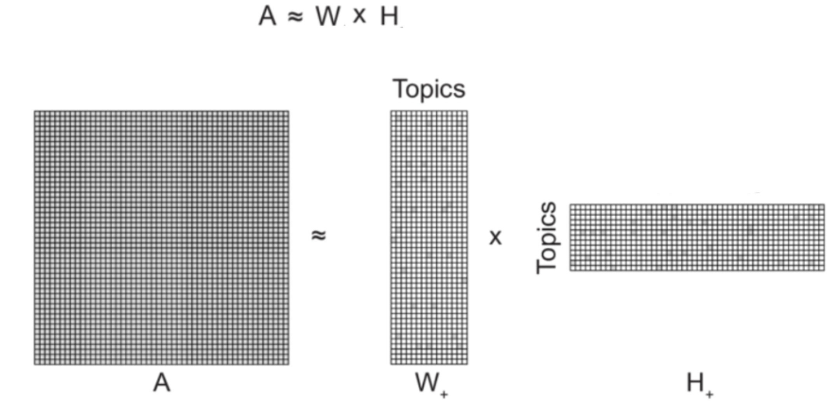
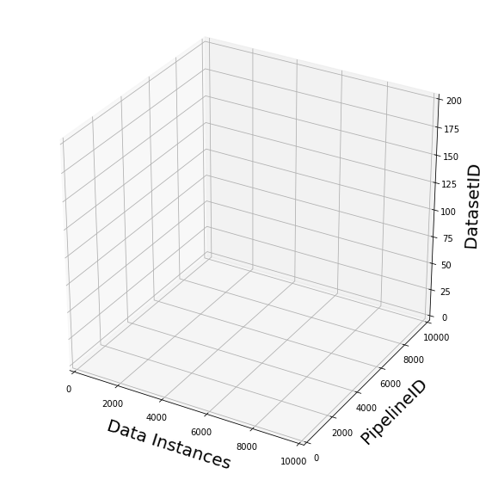
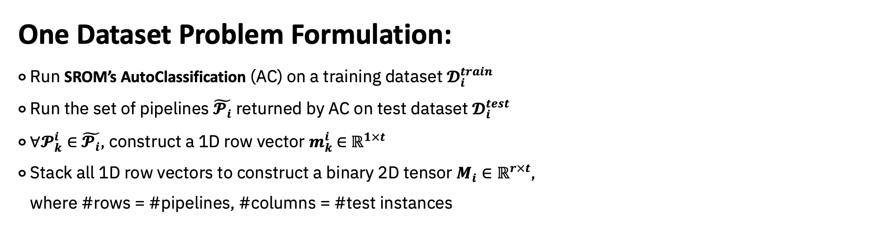
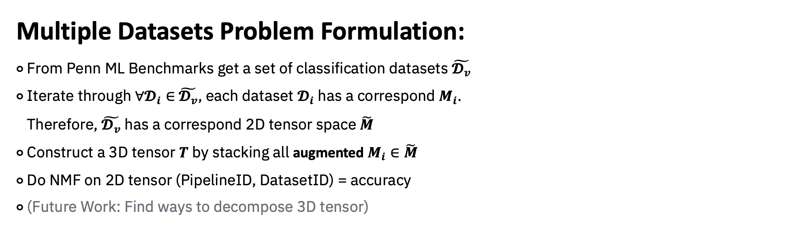
One Dataset Problem Formulation:
⚬ Run SROM’s AutoClassification (AC) on a training dataset $𝓓_{i}^{train}$
⚬ Run the set of pipelines $\tilde{𝓟_{i}}$ returned by AC on test dataset $𝓓_{i}^{test}$
⚬ $∀𝓟_{k}^{i}∈$ $\tilde{𝓟_{i}}$, construct a 1D row vector $m_{k}^{i}$ $∈$ $ℝ^{1×t}$
⚬ Stack all 1D row vectors to construct a binary 2D tensor $M_{i}∈ℝ^{r×t}$,
where #rows = #pipelines, #columns = #test instances
M
Test data instances
Test data instances
Pipelines
Pipelines
M
Multiple Datasets Problem Formulation:
⚬ From Penn ML Benchmarks get a set of classification datasets $\tilde{𝓓_{v}}$
⚬ Iterate through $∀𝓓_{i}∈$ $\tilde{𝓓_{v}}$, each dataset $𝓓_{i}$ has a correspond $M_{i}$.
Therefore, $\tilde{𝓓_{v}}$ has a correspond 2D tensor space $\tilde{M}$
⚬ Construct a 3D tensor $T$ by stacking all augmented $M_{i}∈\tilde{M}$
⚬ Do NMF on 2D tensor (PipelineID, DatasetID) = accuracy
⚬ (Future Work: Find ways to decompose 3D tensor)

Slide 6
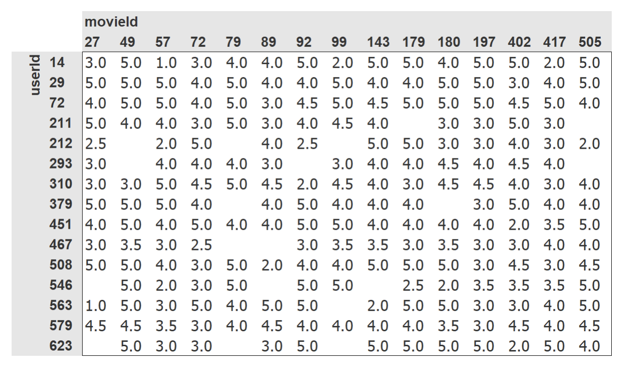
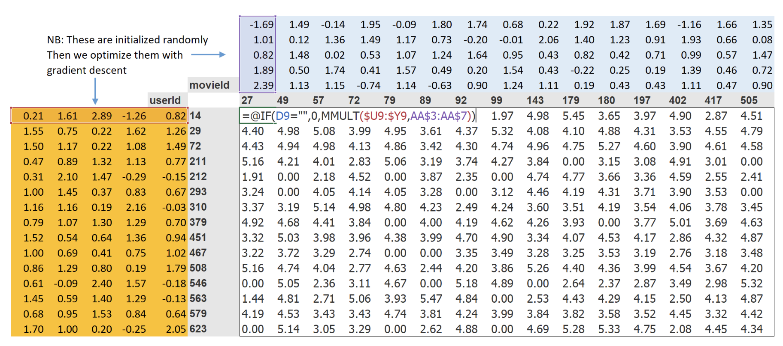

Collaborative Filtering
Data
Learning the Latent Factors
DatasetID/InstanceID (D-id)
H
dataset_factors (instance_factors)
(n_factors=5)
M
PipelineID (P-id)
D-id
P-id
 | Matrix M entries
DataInstanceID (one dataset) | Prediction of each pipelines on each data instances
DatasetID (multiple datasets) | Prediction accuracy of each pipelines on each dataset
W
pipeline_factors
(n_factors=5)
Prediction = W $×$ H

Slide 7
One Dataset Case

Slide 8
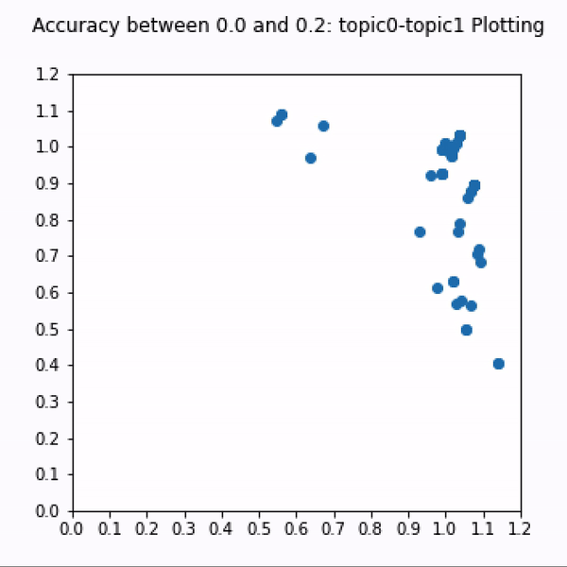
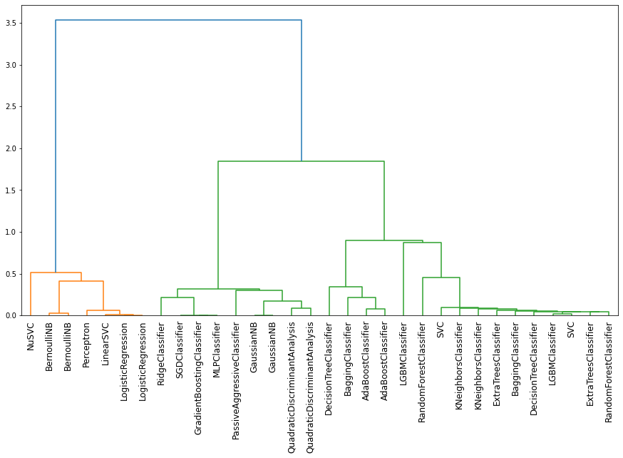
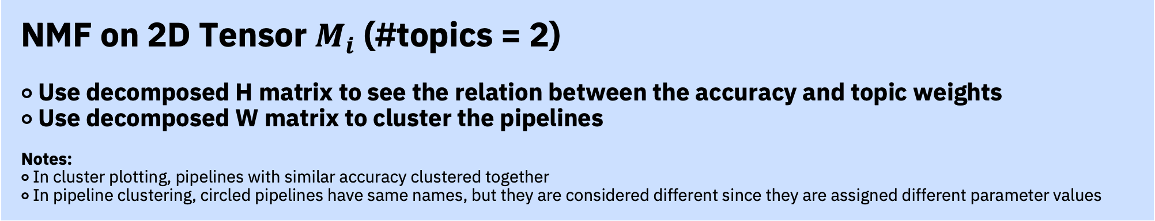
NMF on 2D Tensor $M_{i}$ (#topics = 2) ⚬ Use decomposed H matrix to see the relation between the accuracy and topic weights ⚬ Use decomposed W matrix to cluster the pipelines Notes: ⚬ In cluster plotting, pipelines with similar accuracy clustered together ⚬ In pipeline clustering, circled pipelines have same names, but they are considered different since they are assigned different parameter values

Slide 9
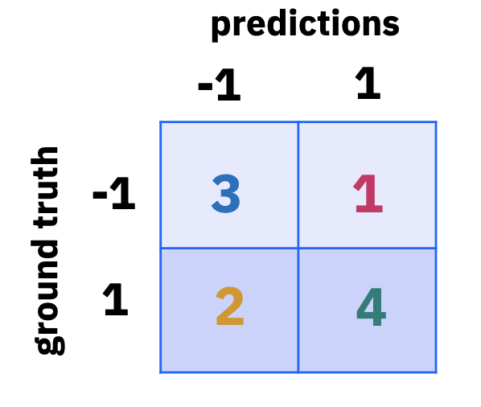
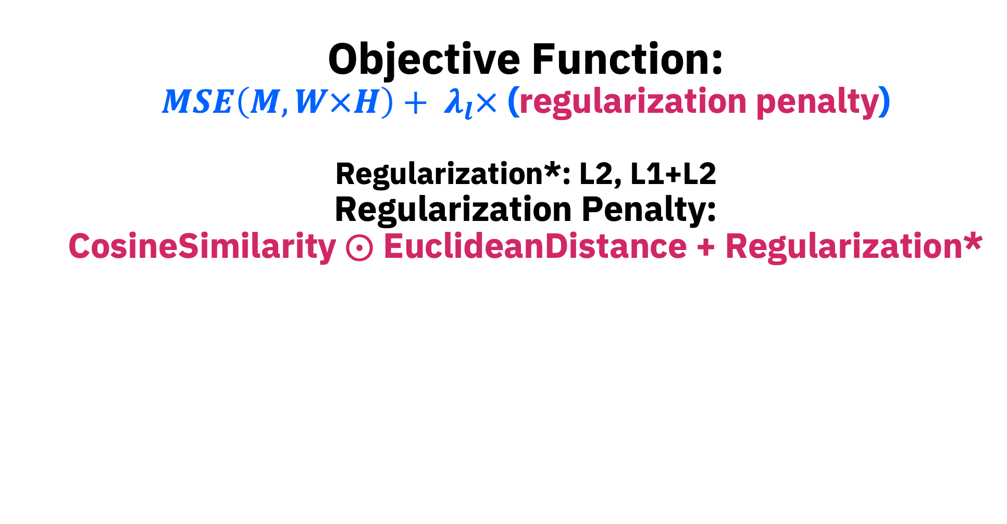
Objective Function: $$MSE\left(M, W×H\right)+ λ_{l}×\text{ (}\text{regularization} \text{penalty}\text{)}$$ Regularization*: L2, L1+L2 Regularization Penalty: CosineSimilarity $⨀$ EuclideanDistance + Regularization*

Slide 10
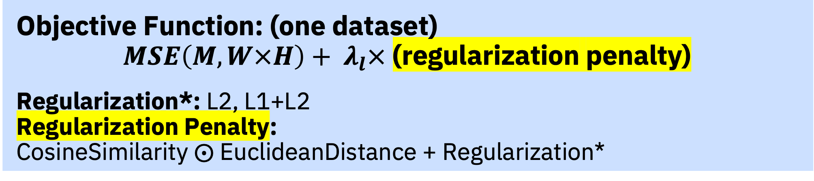
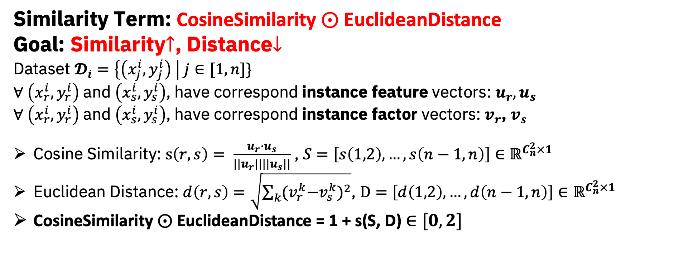
Objective Function: (one dataset) $$MSE\left(M, W×H\right)+ λ_{l}× \text{(}\text{regularization} \text{penalty}\text{)}$$ Regularization*: L2, L1+L2 Regularization Penalty: CosineSimilarity $⨀$ EuclideanDistance + Regularization*
Similarity Term: CosineSimilarity $⨀$ EuclideanDistance
Goal: Similarity$↑$, Distance$↓$
Dataset $𝓓_{i}=\left\{\left(x_{j}^{i},y_{j}^{i}\right) \right| j∈[1, n]\}$
$∀ \left(x_{r}^{i},y_{r}^{i}\right)$ and $\left(x_{s}^{i},y_{s}^{i}\right)$, have correspond instance feature vectors: $u_{r},u_{s}$
$∀ \left(x_{r}^{i},y_{r}^{i}\right)$ and $\left(x_{s}^{i},y_{s}^{i}\right)$, have correspond instance factor vectors: $v_{r}$, $v_{s}$
Cosine Similarity: $s\left(r,s\right)= \frac{u_{r}∙u_{s}}{||u_{r}|||{|u}_{s}||}$ , $S=\left[s\left(1,2\right), …, s\left(n−1, n\right)\right]∈ℝ^{C_{n}^{2}×1}$
Euclidean Distance: $d\left(r, s\right)=\sqrt{\sum_{k}{{{(v}_{r}^{k}−v_{s}^{k})}^{2}}}$, $D=\left[d\left(1,2\right), …, d\left(n−1, n\right)\right]∈ℝ^{C_{n}^{2}×1}$
CosineSimilarity $⨀$ EuclideanDistance = 1 + s(S, D) $∈[0, 2]$

Slide 11
L2-Regularization
Weight Decay
Similarity:
Add a contribution / regularization to the machine learning models to encourage the weights to be as small as possible to prevent overfitting.
L2 regularization is added to the loss
weight decay is added directly to the update rule

Slide 12
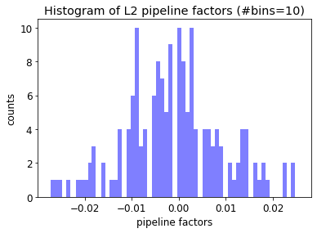
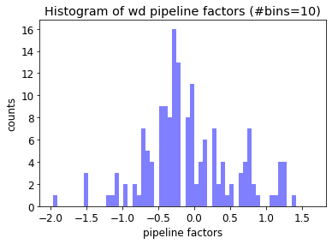
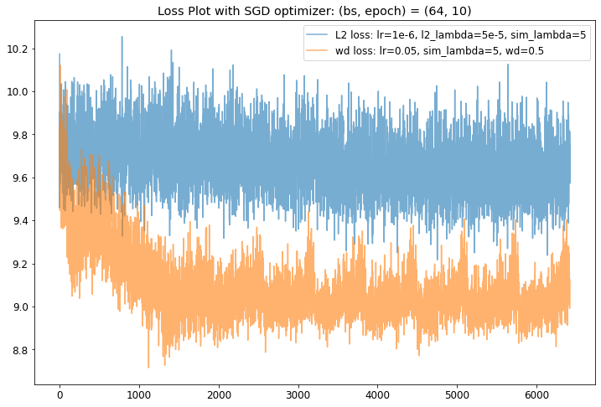
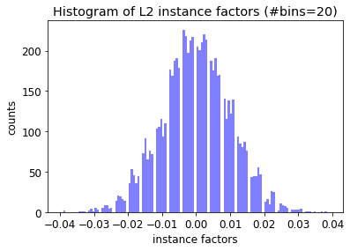
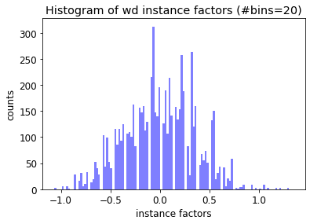
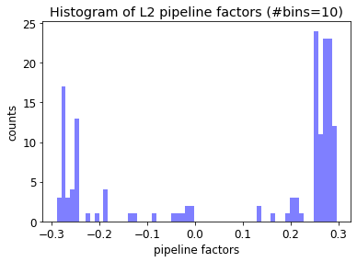
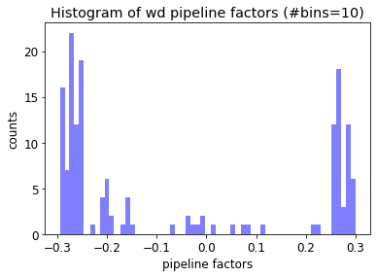
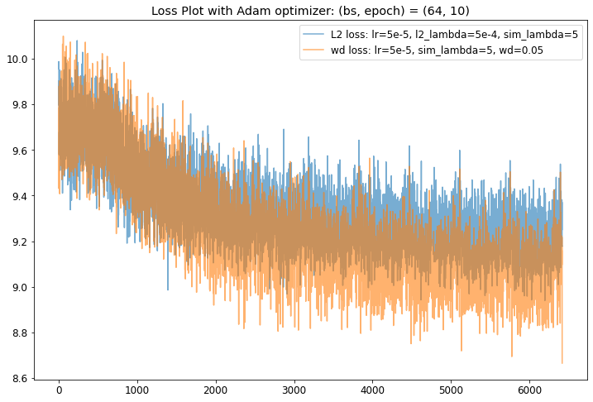
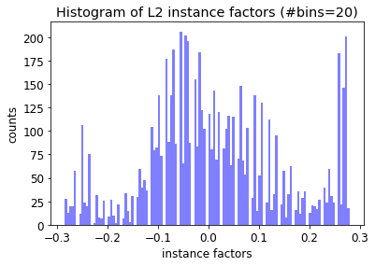
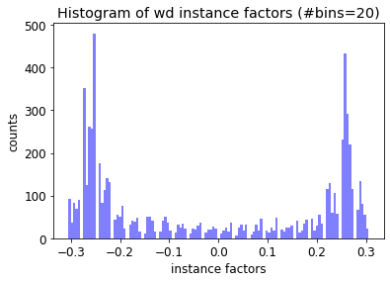
Loss Plot with n_factors=5 (#pipelines=31; #instances=1325) |  | Histogram of pipeline_factors & instance_factors
 |  | L2 Reg | Weight Decay
SGD Optimizer | pipeline factors
 | instance factors
Adam Optimizer | pipeline factors
 | instance factors

Slide 13
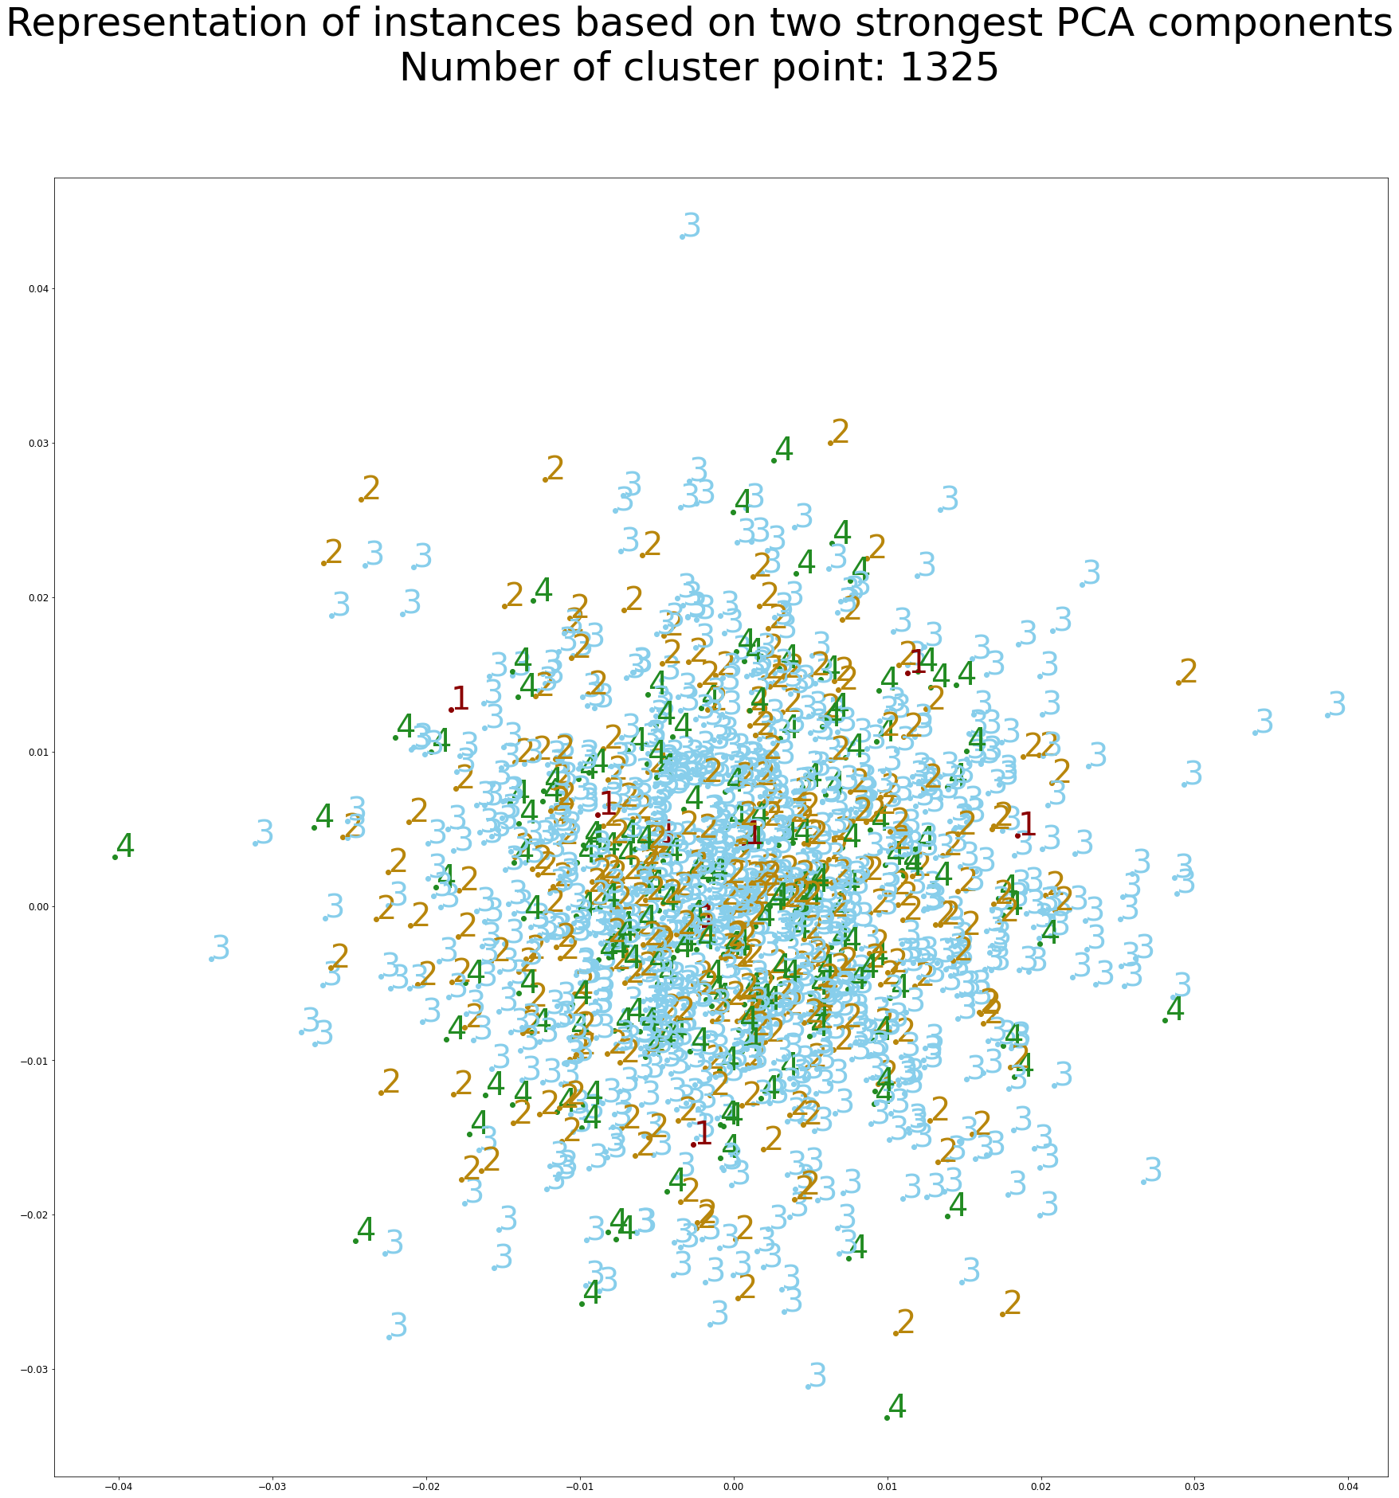
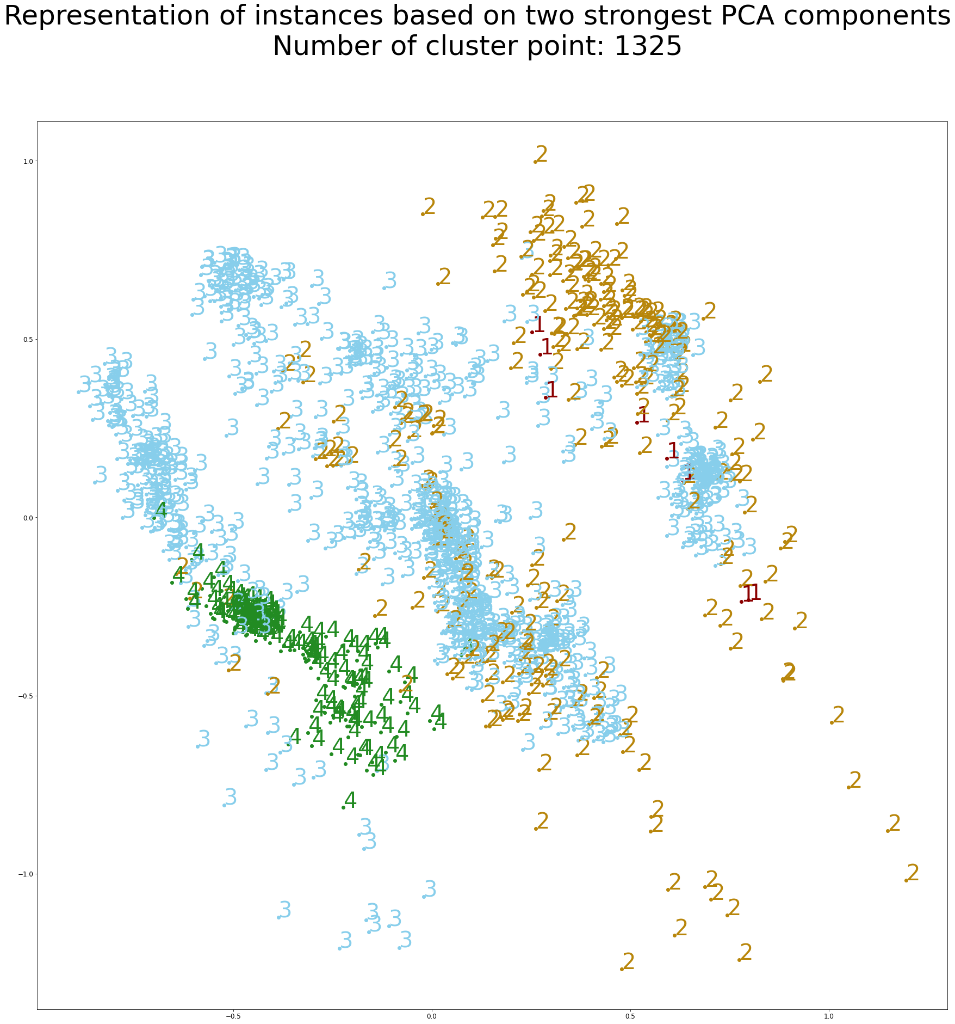
SGD Optimizer: Representation of instances based on two strongest PCA components
L2 Reg | Weight Decay
1
4

Slide 14
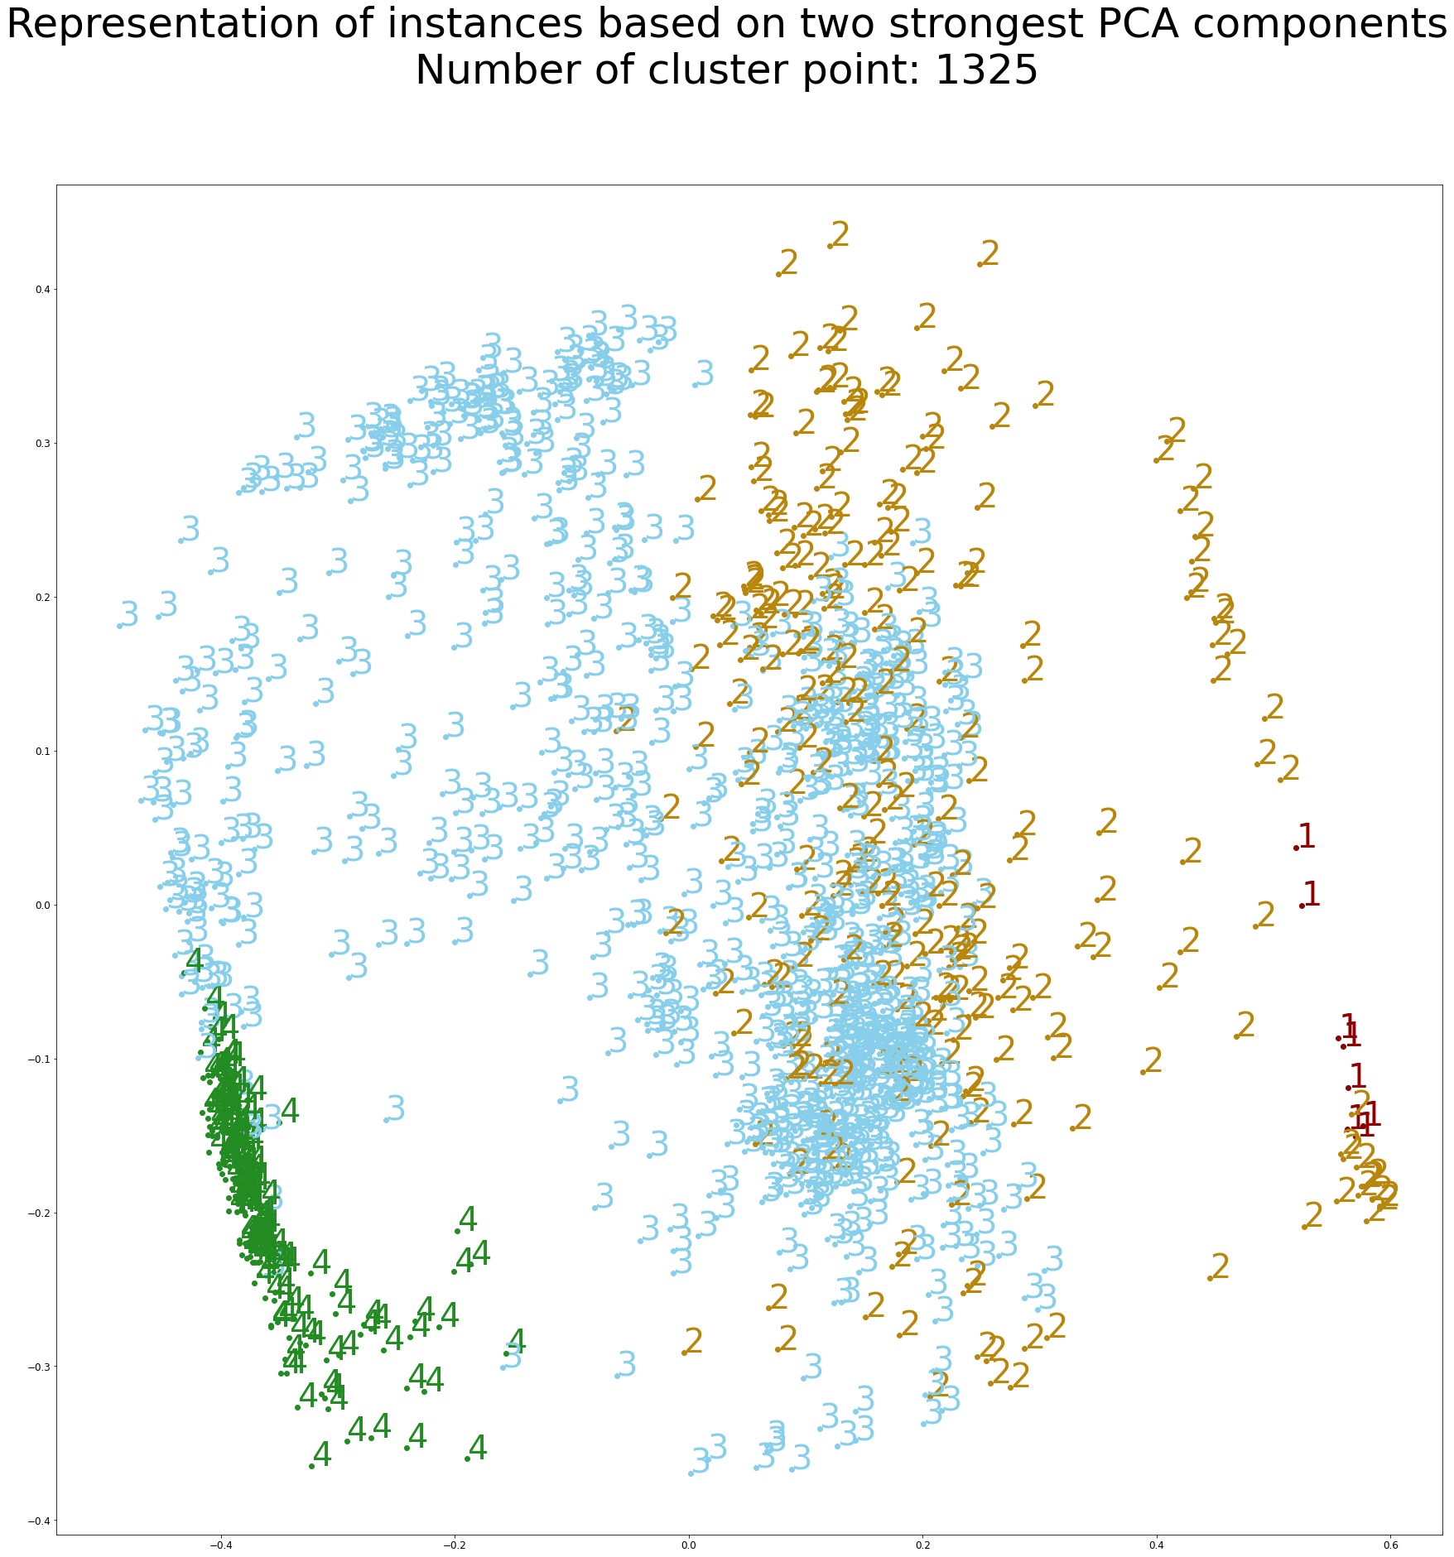
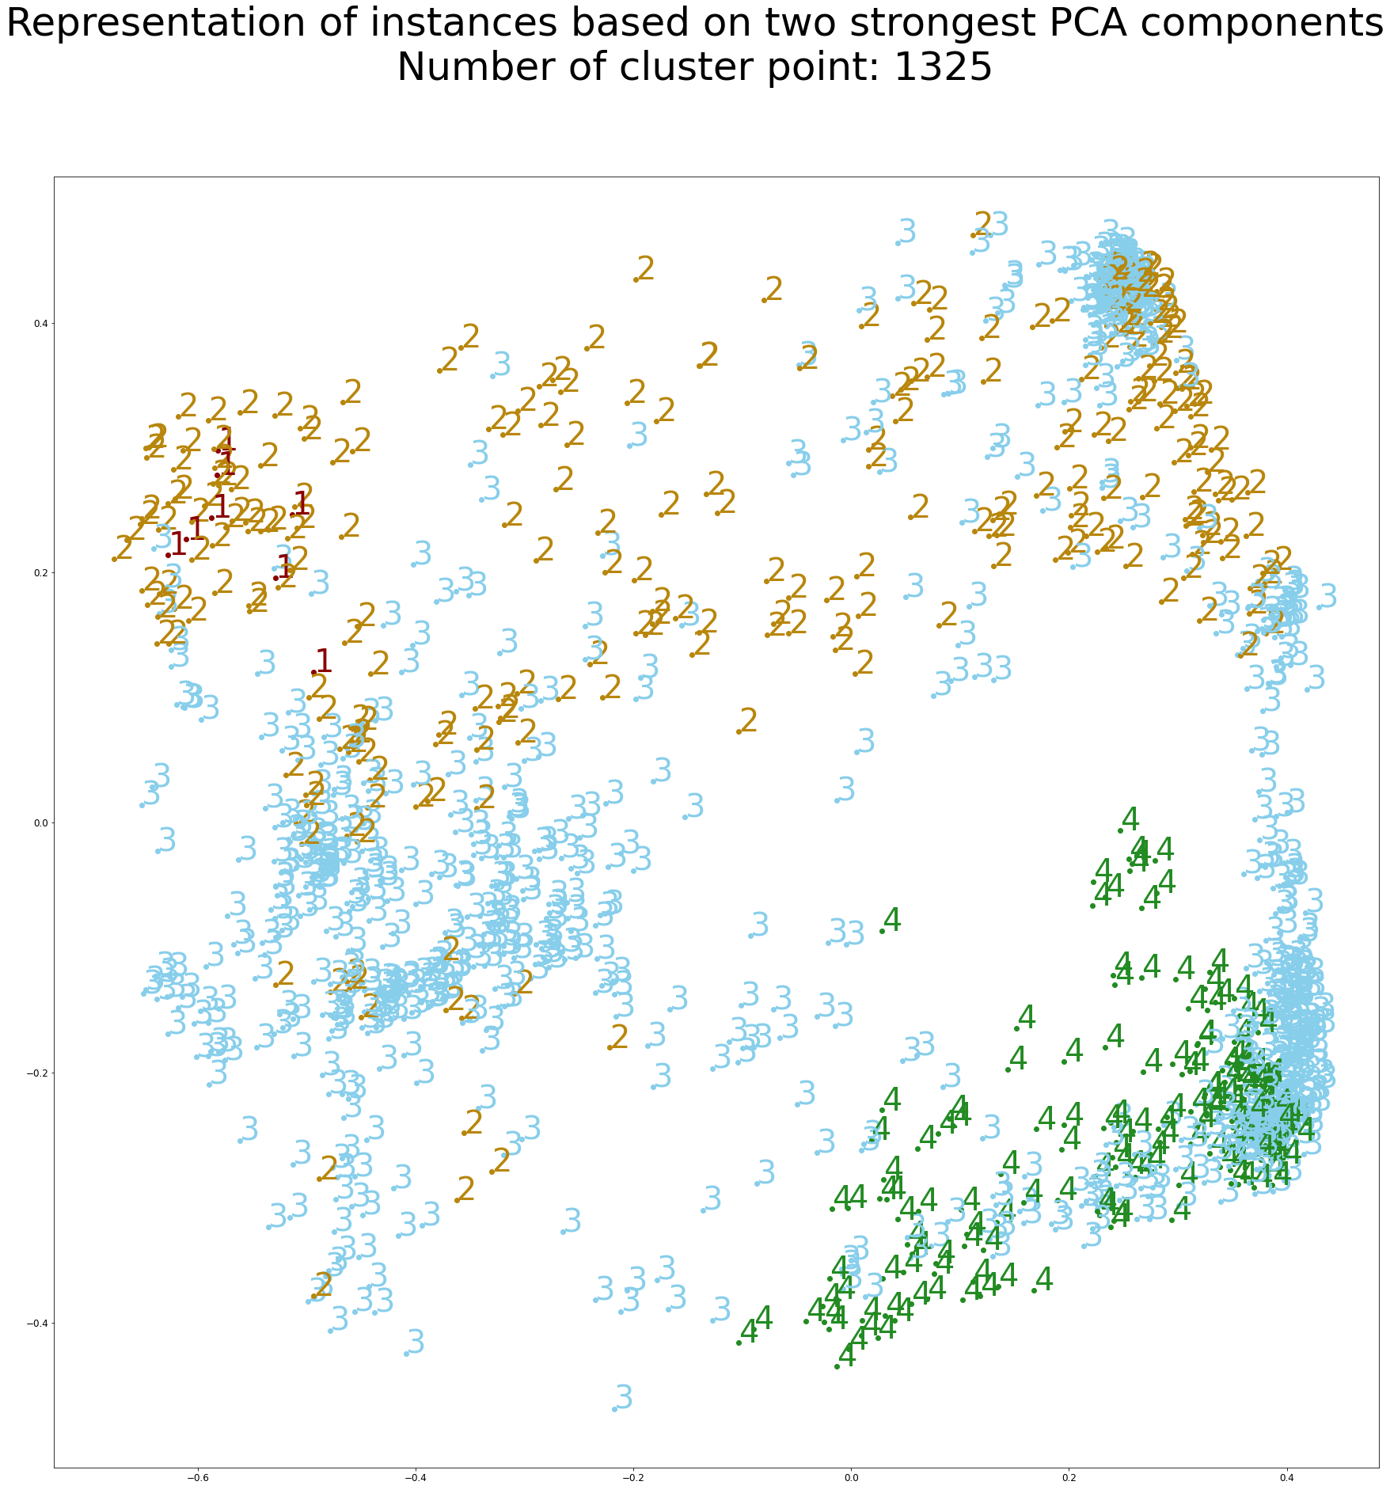
Adam Optimizer: Representation of instances based on two strongest PCA components
L2 Reg | Weight Decay

Slide 15
Adam Optimizer: Representation of instances based on two strongest PCA components
L2 Reg | Weight Decay
2
3
1
1
4
4

Slide 16
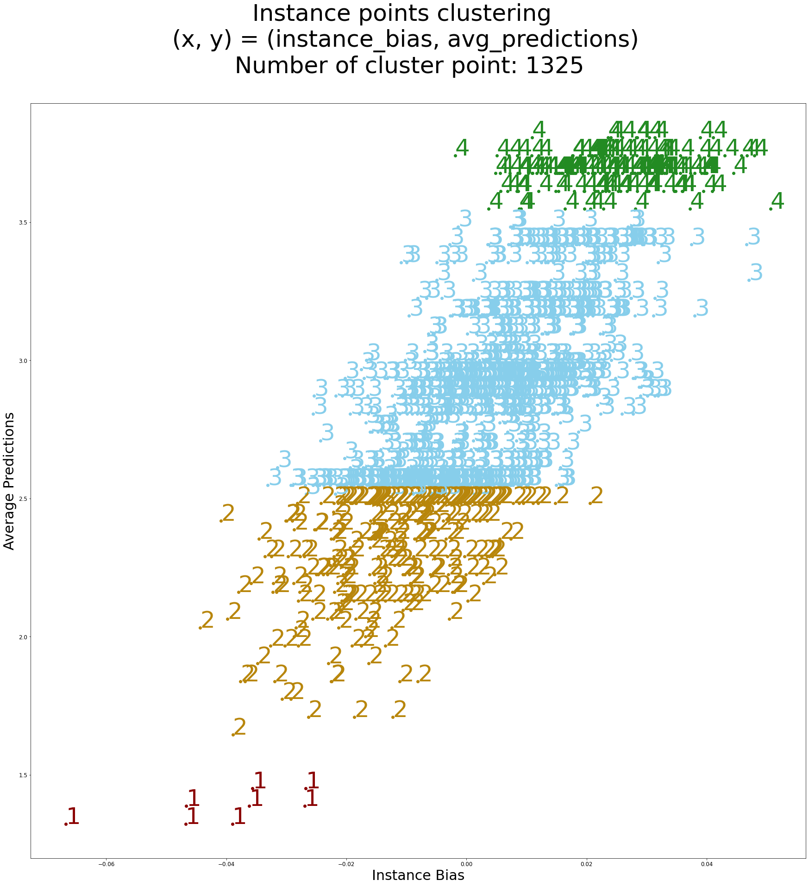
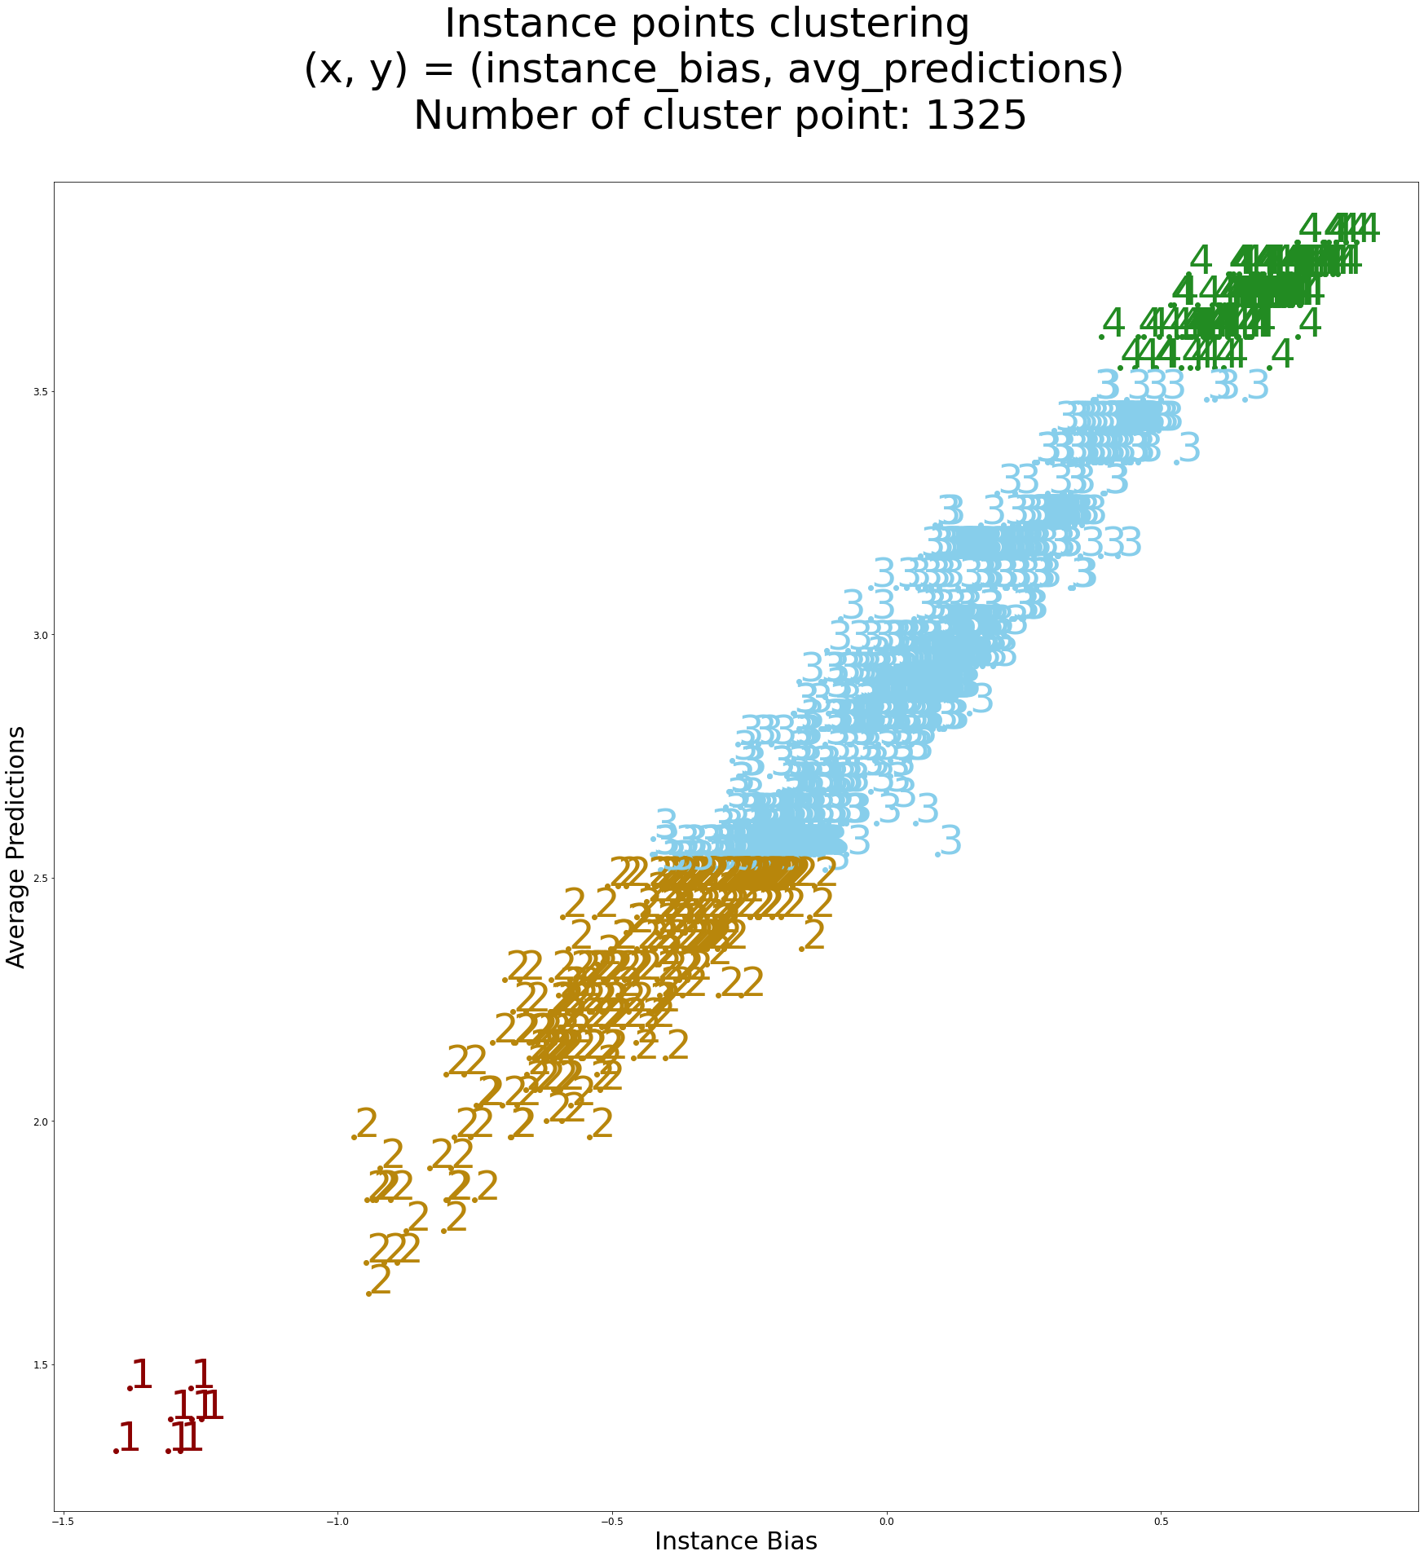
SGD Optimizer: (x, y) = (instance_bias, avg_predictions)
L2 Reg | Weight Decay

Slide 17
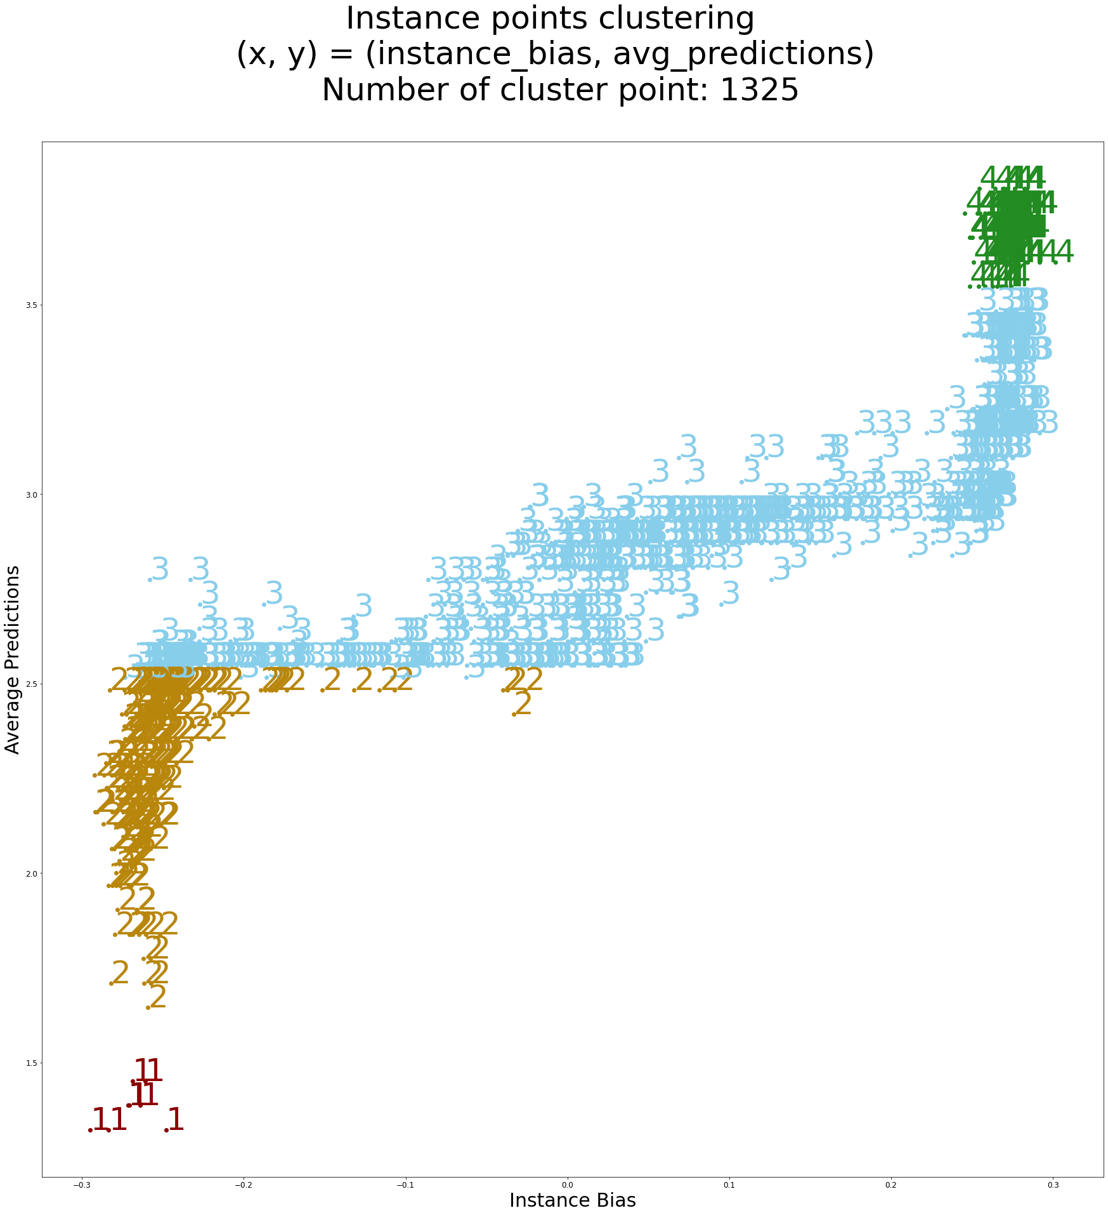
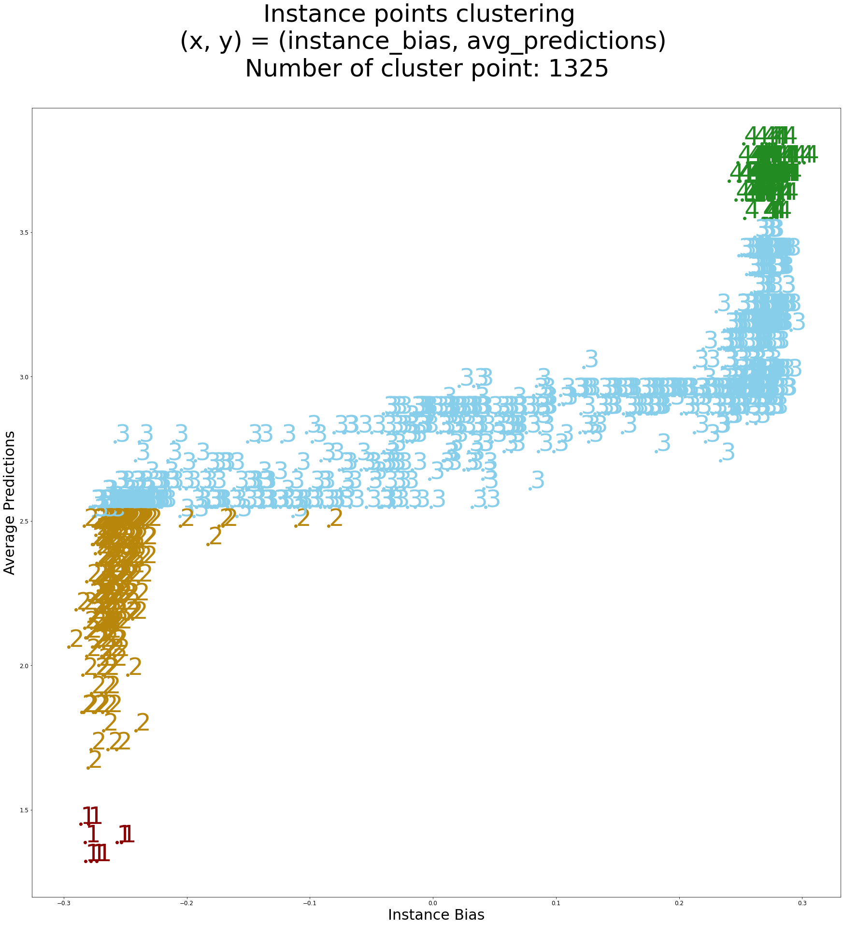
Adam Optimizer: (x, y) = (instance_bias, avg_predictions)
L2 Reg | Weight Decay

Slide 18
Multiple Datasets Case

Slide 19
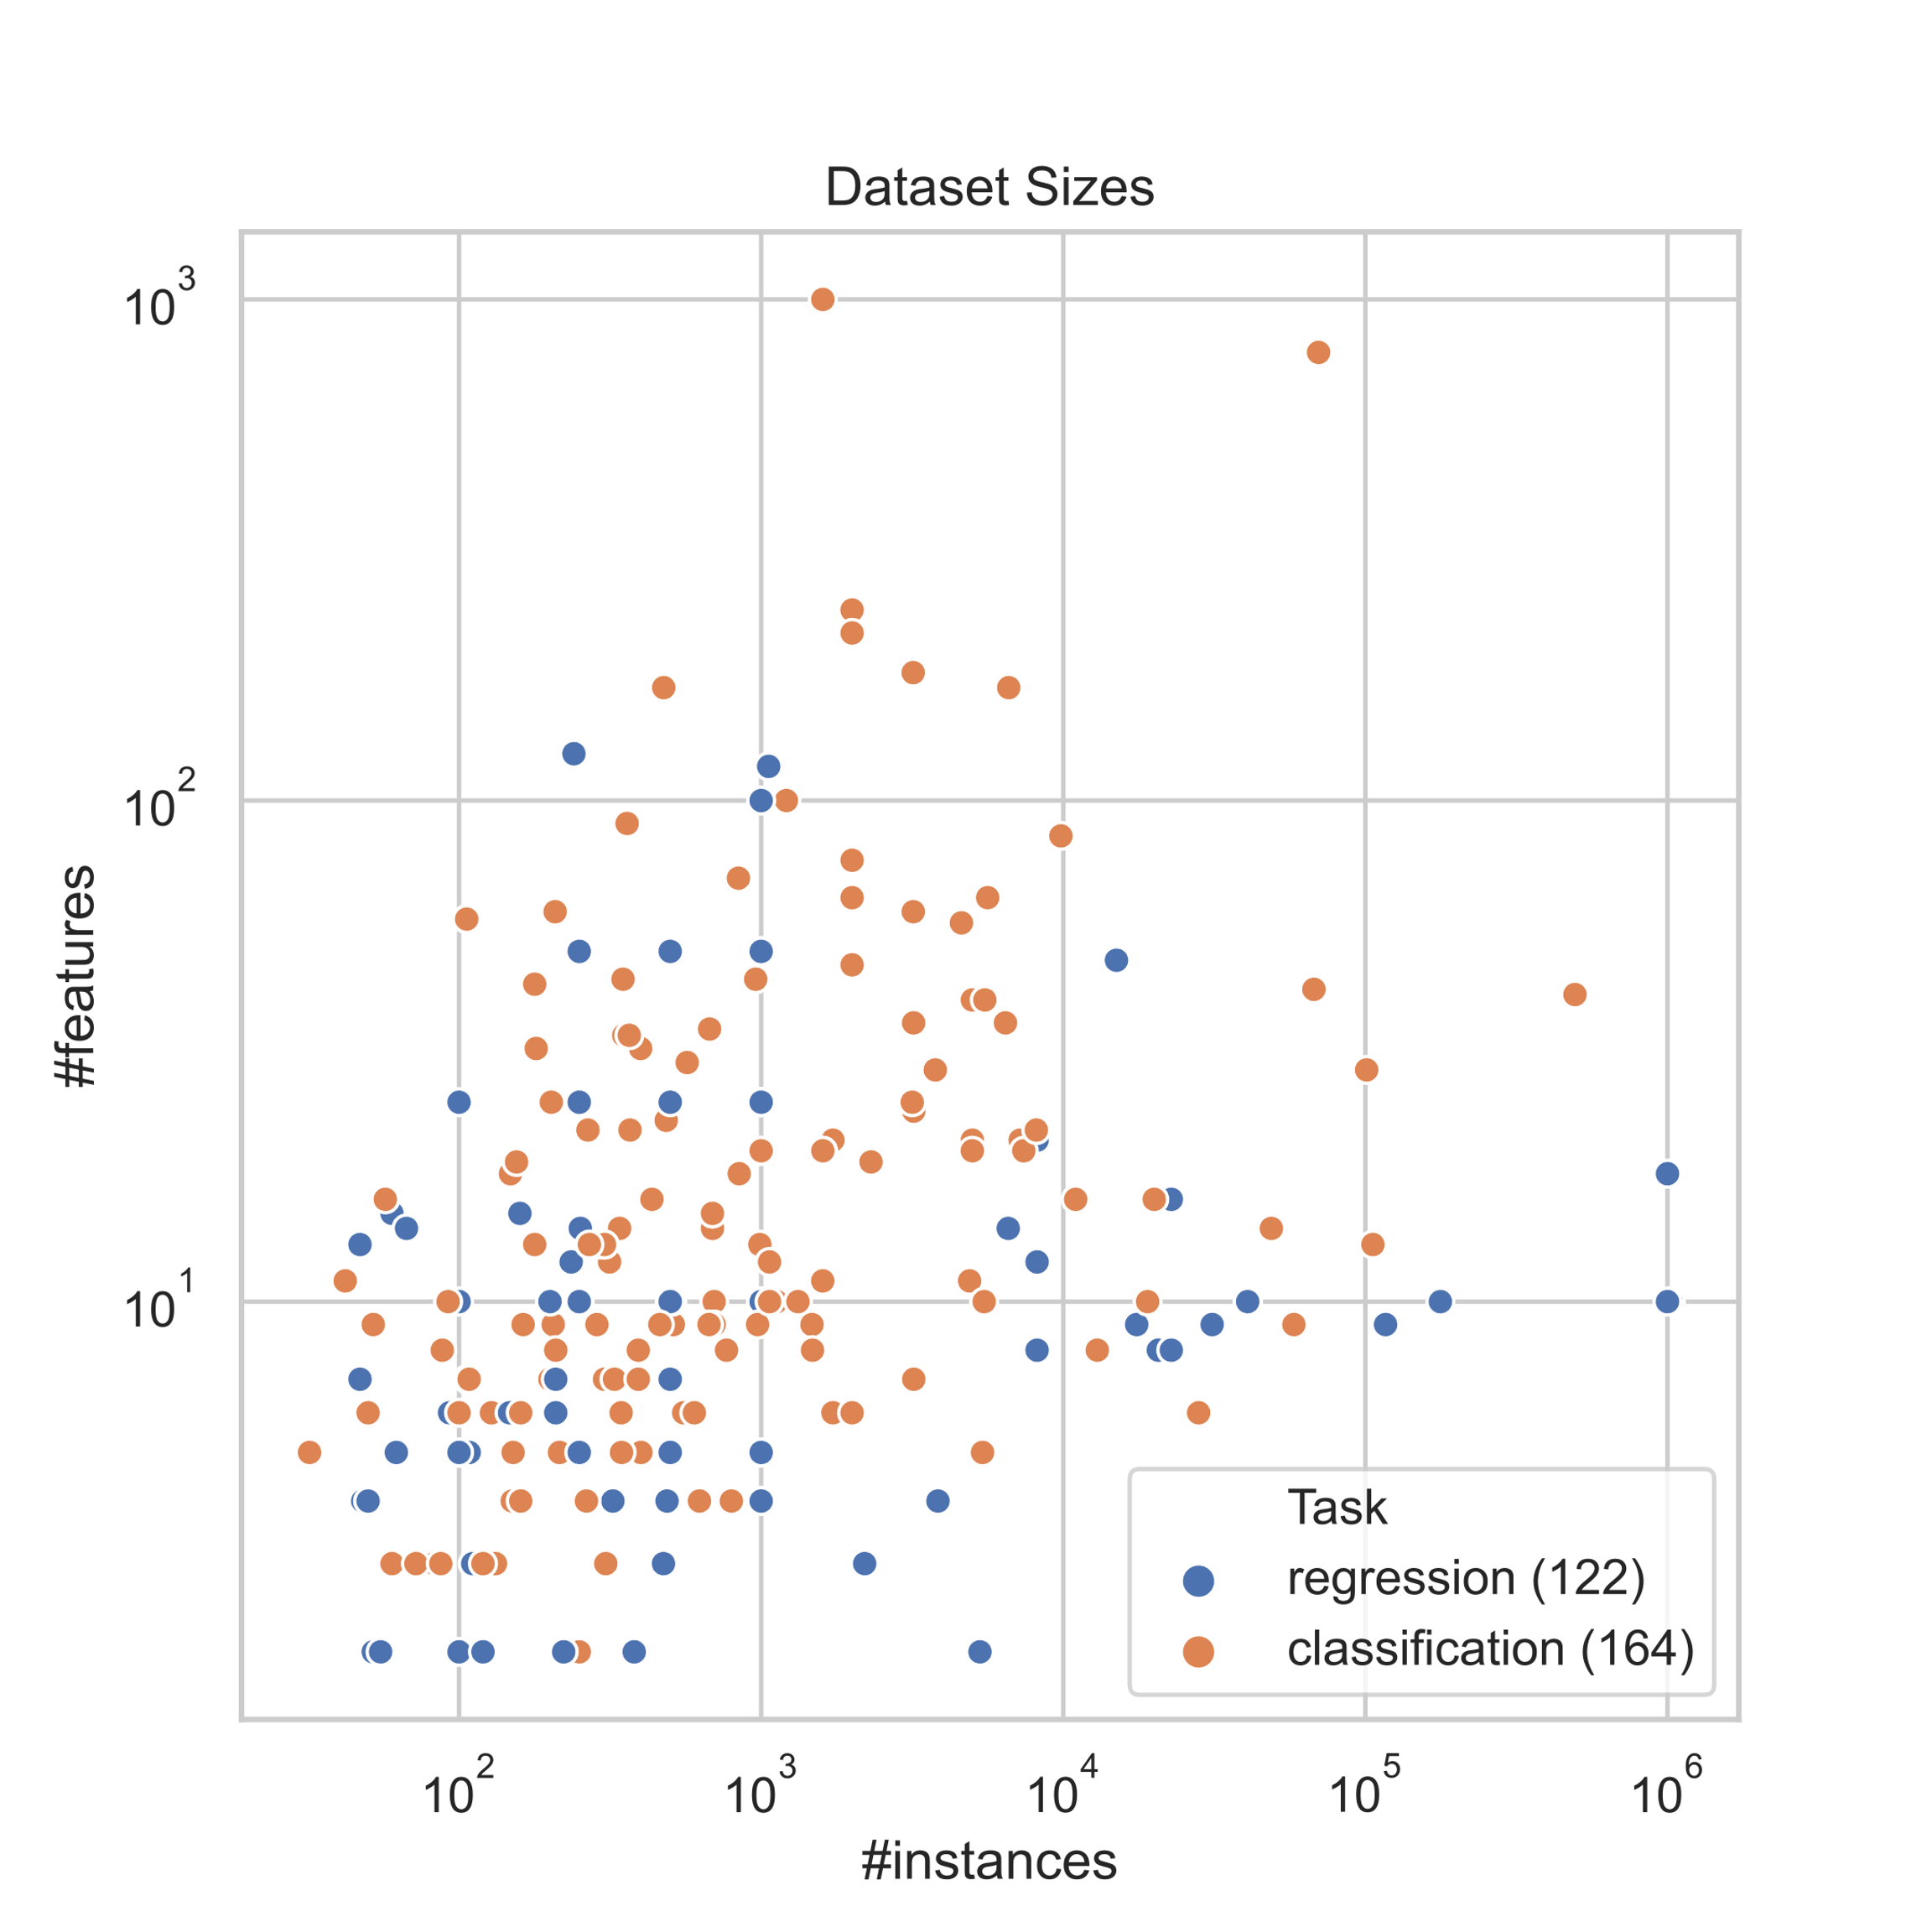
Multiple Classification Datasets: Penn Machine Learning Benchmarks
⚬ Run SROM AutoClassification on all 164 Classification datasets
⚬ Generate 7478 distinct pipelines for 121 Classification datasets
⚬ For each datasets, use the generated pipelines do the predictions
⚬ Optimize number of distinct pipelines among 121 datasets:
Each pipeline is only differed by the step names, ignore the difference between parameter numbers / names / values
121 distinct datasets
830 distinct pipelines
#Pipelines with (1 step, 2 steps, 3 steps, 4 steps) = (21, 805, 2, 2)
76 distinct steps

Slide 20
Sparse Tensor
DatasetID
Examples from SROM output:
Pipeline(steps=[('bernoullinb', BernoulliNB(binarize=0.75, fit_prior=False))])
Pipeline(steps=[('bernoullinb’, BernoulliNB(alpha=0.001, binarize=0.9, fit_prior=False))])
Pipeline(steps=[('featureagglomeration', FeatureAgglomeration()), ('adaboostclassifier’, AdaBoostClassifier(learning_rate=0.5, n_estimators=500, random_state=42))])]
PipelineID

Slide 21
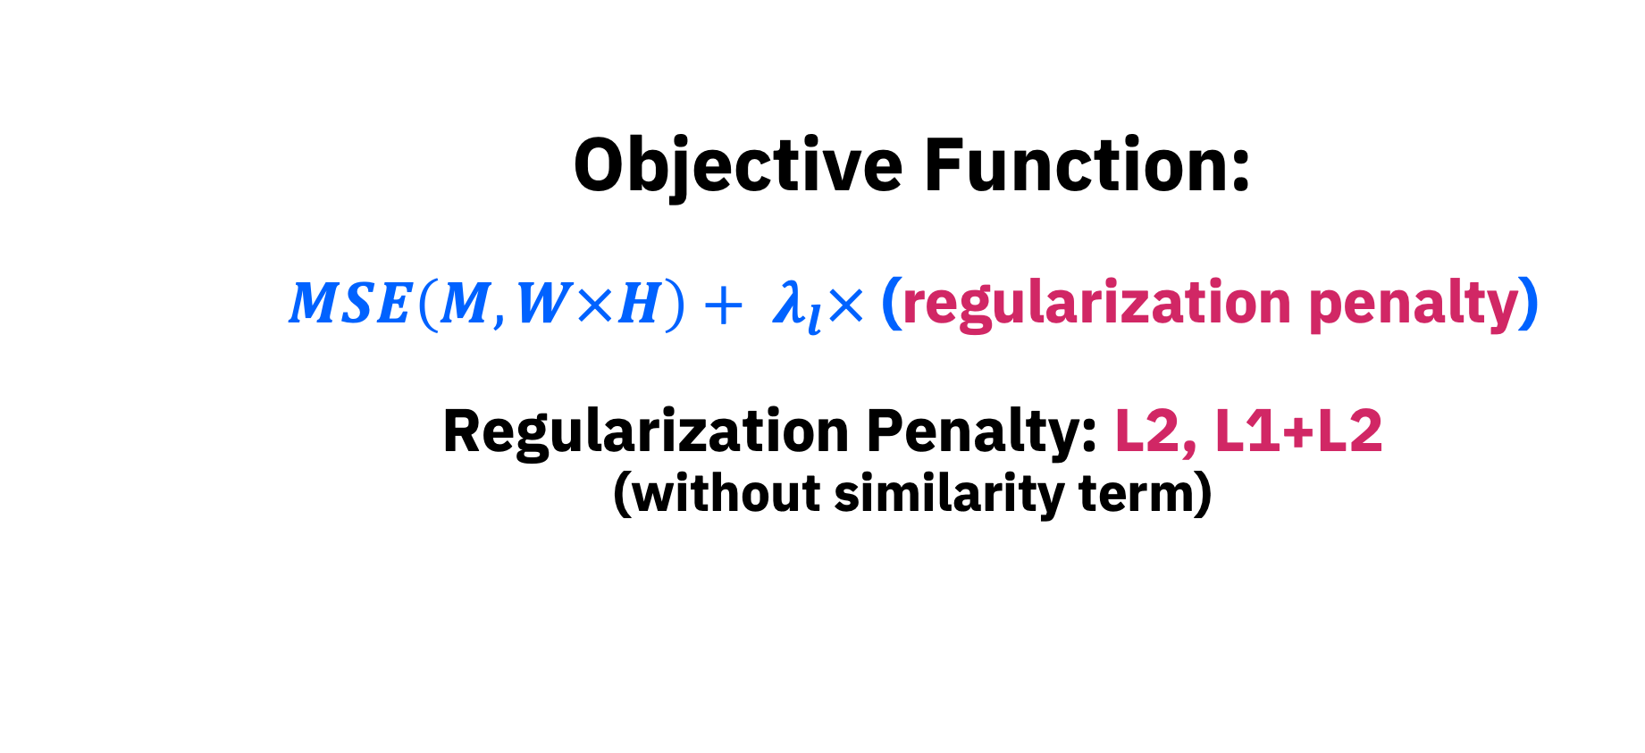
Objective Function: $$MSE\left(M, W×H\right)+ λ_{l}×\text{ (}\text{regularization} \text{penalty}\text{)}$$ Regularization Penalty: L2, L1+L2 (without similarity term)

Slide 22
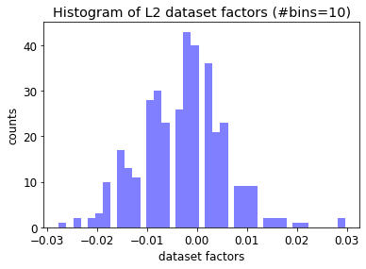
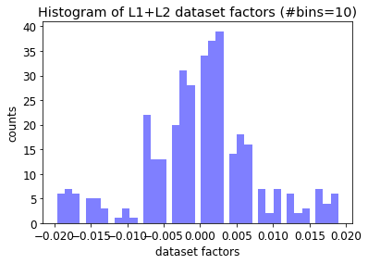
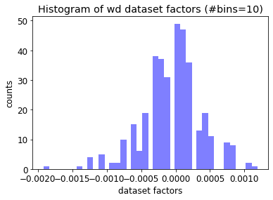
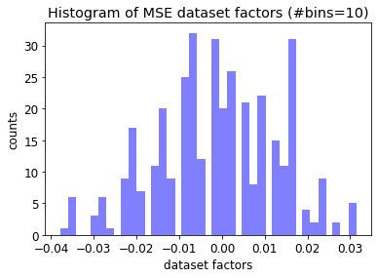
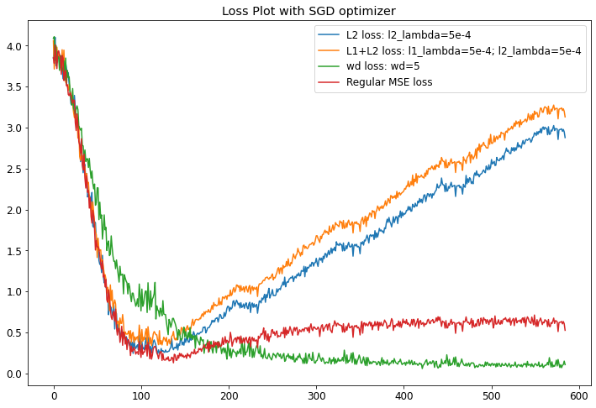
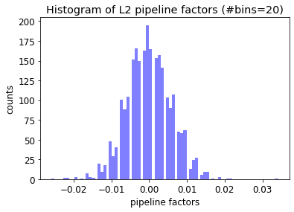
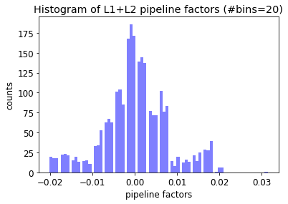
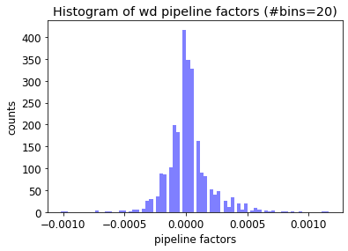
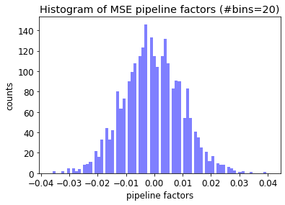
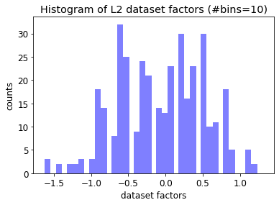
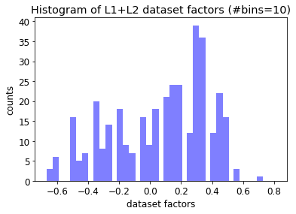
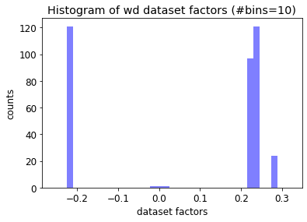
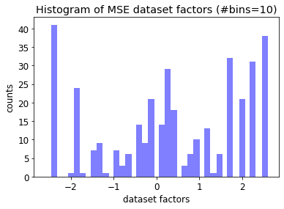
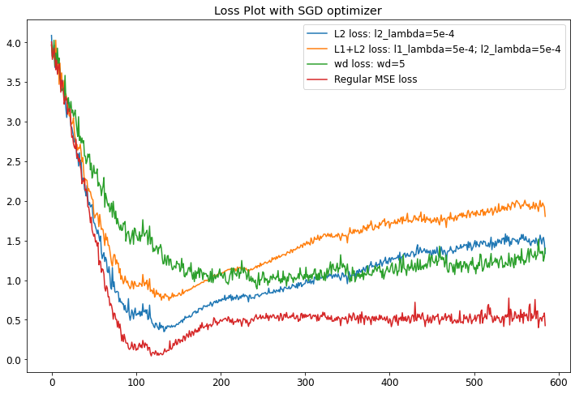




Loss Plot with n_factors=3 L1_lambda=5e-4 L2_lambda=5e-4 wd=5 |  | Histogram of dataset_factors & pipeline_factors
 |  | L2 Reg | L1+L2 Reg | Weight Decay | MSE
SGD Optimizer | dataset factors
 | pipeline factors
Adam Optimizer | dataset factors
 | pipeline factors
Adam

Slide 23


Case:
⚬ Adam optimizer with wd=5
⚬ Only plot top 100 pipelines (by frequency), and add 4 pipelines with 3 or 4 steps
⚬ n_factors=3; PCA’s n_components=3
Observations:
⚬ n_factors=3 $⇒$ 3 clusters
⚬ All pipelines with 1 steps are in cluster1
⚬ All pipelines in cluster2 have 2 steps
⚬ Pipelines with 3 or 4 steps are all in cluster3
Cluster2: 55 points
Avg acc: 0.83
Cluster1: 25 points
Avg acc: 0.74
Cluster3: 24 points
Avg acc: 0.75

Slide 24

Cluster1 (25/25)
Average Accuracy: 0.74
Observations:
All pipelines with 1 steps are in this cluster

Slide 25

Cluster2 (49/55)
Average Accuracy: 0.83
Observations:
All pipelines in this cluster have 2 steps

Slide 26

Cluster3 (21/24)
Average Accuracy: 0.75
Observations:
Pipelines with 3 or 4 steps are in this cluster

Slide 27

Case:
⚬ Adam optimizer with wd=5
⚬ Only plot top 100 pipelines (by frequency), and add 4 pipelines with 3 or 4 steps
⚬ n_factors=3; PCA’s n_components=3
Observations:
⚬ Pipelines with 4 steps are in cluster1
⚬ Pipelines with 3 steps are in cluster2
⚬ Pipelines with 1 steps are in cluster3
cluster1
cluster2
cluster3

Slide 28

Objective Function: $$MSE\left(M, W×H\right)+ λ_{l}×\text{ (}\text{regularization} \text{penalty}\text{)}$$ Regularization*: L2, L1+L2 Regularization Penalty: CCA_ScoreSimilarity + Regularization* (with similarity term)

Slide 29

Canonical Correlation Analysis (CCA):
CCA model the correlations between two datasets:
Focusing on a dependence relationship and model the two datasets in a regression-like manner: dataset $𝓓_{i}$ as a function of dataset $𝓓_{j}$
Focusing on the exploration of the relationships between the two datasets without stating any dataset as the dependent or the independent variables

Slide 30


Objective Function: (multiple datasets) $$MSE\left(M, W×H\right)+ λ_{l}× \text{(}\text{regularization} \text{penalty}\text{)}$$ Regularization*: L2, L1+L2 Regularization Penalty: CCA_ScoreSimilarity + Regularization*
Similarity Term: CCA_Score
Goal: Similarity$↑$, CCA_Score $↑$
For $∀$ $𝓓_{i},𝓓_{j}∈\tilde{𝓓_{v}}$ , where $𝓓_{i},𝓓_{j}$ are the datasets in the dataset space $\tilde{𝓓_{v}}$
Acc score Similarity: $CCA_Score\left(𝓓_{i},𝓓_{j}\right)=CCA\left(𝓓_{i},𝓓_{j}\right)+CCA(𝓓_{j},𝓓_{i})$

Slide 31


Adam + Weight Decay

Slide 32


TSNE Clustering: n_factor=40
(x, y) = (TSNE_factor[0], TSNE_factor[1])
Observations:
Datasets with similar accuracy clustered together
Overall, in a y=x trend, and as accuracy increase y increase

Slide 33


TSNE Clustering: n_factor=40
(x, y) = (TSNE_factor[0], avg_accuracy)
Observations:
Datasets with similar accuracy clustered together
Overall, in a y=x trend, and as accuracy increase y increase
Aside:
Result Analysis: Linear Regression with (Xs, Y) = (TSNE_factorsavg_accuracy)
$R^{2} ≈0.8$

Slide 34
Testing Result Split the dataset into Training dataset : Testing dataset = 9:1 Then, further split training dataset into train : validation = 8:2
Adam + wd (Train(train:validation=8:2):test = 9:1)
Baseline: MovieLens_100K (User-movie) Set feature vector as np.ones(), i.e.: identical features for all instances | Acc: ~72.40% (without Similarity Term) | Acc: ~72.36% (with Similarity Term)
One dataset case: “banana” dataset from pmlb (Pipeline-instance) (Binary [0/1] classes & 4 classes [1/2/3/4]) feature vector from original dataset | Acc: ~94.18% (binary classes + Similarity Term) | Acc: ~88.10% (4 classes + Similarity Term)
Multiple datasets case: Penn ML Benchmarks (Pipeline-dataset) Set feature vector as np.ones(), i.e.: identical features for all instances | Acc: ~70.55% (without Similarity Term) | Acc: ~67.81% (with Similarity Term)
Multiple datasets case: Penn ML Benchmarks (Pipeline-dataset) Set feature vector as CCA_score | Acc: ~70.55% (without Similarity Term) | Acc: ~70.55% (with Similarity Term)
SGD + L1&L2 (Train(train:validation=8:2):test = 9:1) [NOT GOOD]
Baseline: MovieLens_100K (User-movie) Set feature vector as np.ones(), i.e.: identical features for all instances | Acc: ~68.65% (without Similarity Term) | Acc: ~68.64% (with Similarity Term)
One dataset case: “banana” dataset from pmlb (Pipeline-instance) (Binary [0/1] classes & 4 classes [1/2/3/4]) feature vector from original dataset | Acc: ~29.69% (binary classes + Similarity Term) | Acc :~65.25% (4 classes + Similarity Term)
Multiple datasets case: Penn ML Benchmarks (Pipeline-dataset) Set feature vector as np.ones(), i.e.: identical features for all instances | Acc: ~74.86% (without Similarity Term) | Acc: ~74.87% (with Similarity Term)
Multiple datasets case: Penn ML Benchmarks (Pipeline-dataset) Set feature vector as CCA_score | Acc: ~74.86% (without Similarity Term) | Acc: ~74.86% (with Similarity Term)

Slide 35
Related Techniques
STAGES | RELATED TECHNIQUES
Datasets | Penn Machine Learning Benchmarks
Data Generation | IBM SROM IBM Virtual Machine
Matrix Decomposition | Non-negative matrix factorization (NMF) Principal component analysis (PCA)
Model | Fastai Collaborative Filtering
Regularization | Elastic Regularization (L1, L2)
Optimization | Stochastic gradient descent (SGD) Adam + Weight Decay
Similarity Measurement | Cosine Similarity, Euclidean Distance Canonical Correlation Analysis (CCA)
Data Visualization and Analysis | Clustering (tsne, dendrogram) Histogram Linear Regression

Slide 36
Future Work: ⚬ Improvements: Currently, run IBM’s SROM on Penn ML benchmarks, among 121 distinct classification datasets, generates 830 distinct pipelines, however, most of them are with 1 or 2 steps. It would be better to get more pipelines with 3 or 4 steps. ⚬ Extensions: Find a way to do the 3-dimensional matrix decomposition. Do the same process for the regression problem.
References:
⚬ IBM SROM: https://github.ibm.com/srom/docs/blob/master/notebooks/experimental/auto/auto_classification.ipynb
⚬ Dataset source: https://github.com/EpistasisLab/pmlb/blob/master/README.md
⚬ surprise NMF: https://github.com/klaudia-nazarko/collaborative-filtering-python/blob/master/collaborative-filtering-model-based.ipynb
⚬ fastai Collaborative Filter: https://github.com/fastai/fastbook/blob/master/08_collab.ipynb
⚬ fastai Learner class reference code: https://github.com/fastai/fastbook/blob/master/19_learner.ipynb
⚬ fastai Optimizer class reference source code: https://github.com/fastai/fastai/blob/master/fastai/optimizer.py
Notes:
TimeSHAP: https://arxiv.org/pdf/2012.00073.pdf
(AutoAI)

Slide 37
THANKS

